Slide 1
Topic Mining of Google Play Review : handling Text Data
Galih Rizky R - DSI Bootcamp 2016

Slide 2
Introduction
Problem:
Too much reviews, too little time to observe one-by-one
The higher-ups want to know the big picture, fast
Need quick update to what people think about your app
Suggested Solution :
Topic Analysis

Slide 3
Project Method
Data Gathering
Data Wrangling
Analysis
(in this case, topic analysis)
Visualize and Present

Slide 4

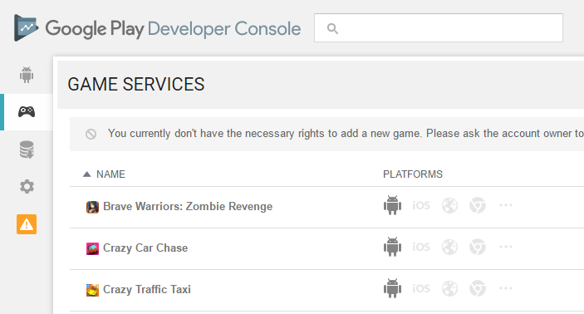
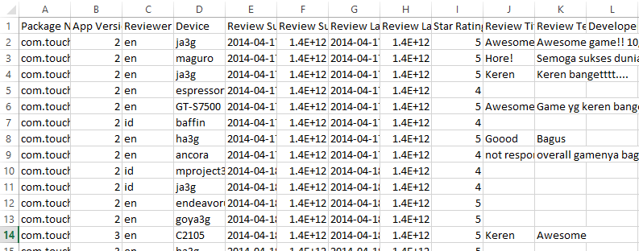
Data Gathering
Raw Data Download : Google Play Developer Console
Or, from anywhere else
Web Scraping
API Services
Manual Writing

Slide 5
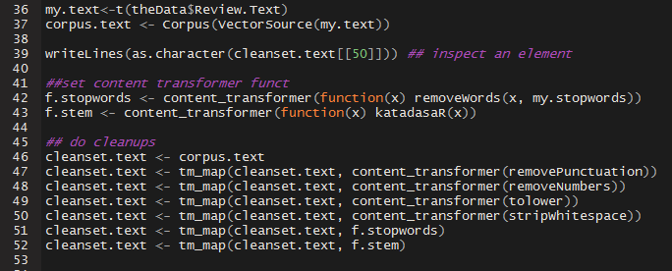
Data Wrangling
The Tricky Part : Text Data Preprocessing (Especially for Bahasa Indonesia)

Slide 6
Data Wrangling (Cont.)
In Detail :
Remove Punctuation. Numbers, and Whitespace
Make them all
lower case
Remove
Stopwords
Transform to
Stem Words

Slide 7
Stop Words
i.e. dan, di, ke, iya, tidak
How? Using a library
Where? Many places,
In this case, I use http://stop-words-list-bahasa-indonesia.blogspot.co.id/2012/09/daftar-stop-words-list-bahasa-indonesia.html
It does not stop there. Library needs to and will continue to grow.

Slide 8
Stem words
i.e. Dibuka, menyebalkan, mencintai (the meaning of the origin words can be different)
How? Using Stemming Algorithm
Do not know stemming algorithm? Ask nicely to someone else to do it
How to do that? Use API web service / open source code
In this case : nurandi/katadasaR
Basic Concept of Algorithm : Nazief and Mirna’s Algorithm

Slide 9
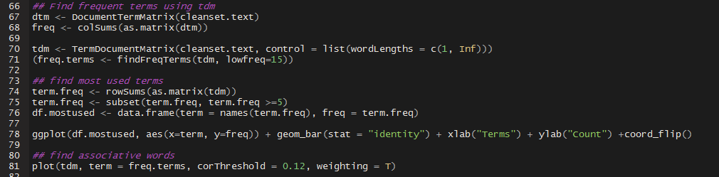
Post-Preprocessing
Use Document Term Matrix to know the term and frequency of terms of the review data.
Play around with it

Slide 10

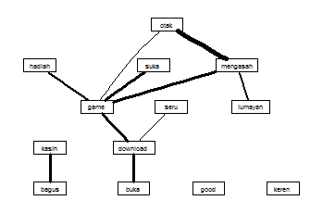
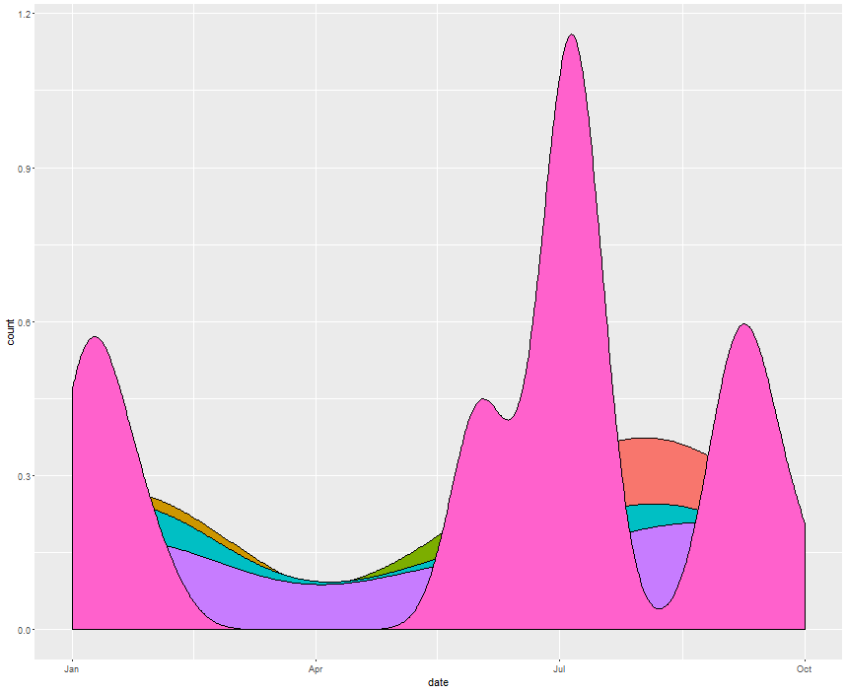
Analysis

